Slide 1
High performance coding with .NET Core and C#
Gergely Kalapos
Dynatrace
gergely.kalapos@dynatrace.com
Web: www.kalapos.net
Twitter: @gregkalapos

Slide 2
Gergely Kalapos (Gergö) Web: http://kalapos.net Twitter: @gregkalapos
Studied Software Engineering at JKU - Linz
Works on performance monitoring tools for .NET at Dynatrace
Born in Hungary, lives in Austria
Notes:
My name is Greg Kalapos and I will guide you through this course.
I’m a software engineering specialized on .NET and Microsoft technologies. I started working with .NET around 2008 as a university student and my current job is to create performance monitoring tools for .NET.
I spend the last almost 2 years working with .NET core and creating performance monitoring tools specifically for .NET Core.
And you may wonder where my accent is from, so here the answer: I was born in Hungary, but I spent the last 6 years living in Austria.
You can reach me through my website, or you can tweet me at gregkalapos.

Slide 3
Part 1: Intro
Notes:
All right, Let’s discuss what we will learn in this course!

Slide 4
Content
Part 1: Why do we care about this topic?
Part 2: Measuring performance
Part 3: Making applications faster
Part 4: Data Access Layer performance
Part 5: Performance monitoring in production

Slide 5
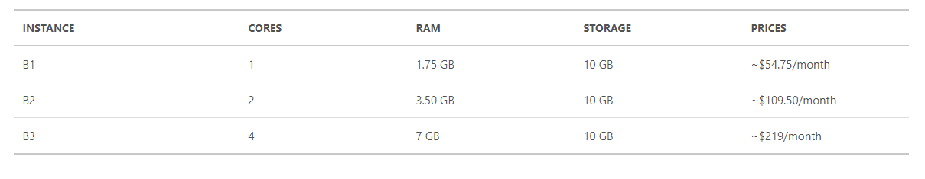
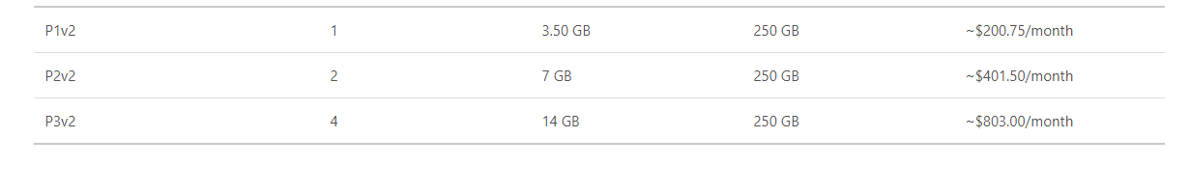
Why is this important? – Cloud
Azure App Service pricing
Standard:
If your app runs on a
B1 machine: 54,75$/month
P3v2 machine: 803$/month
50 P3v2 machine: 40150$/month
Premium:

Slide 6
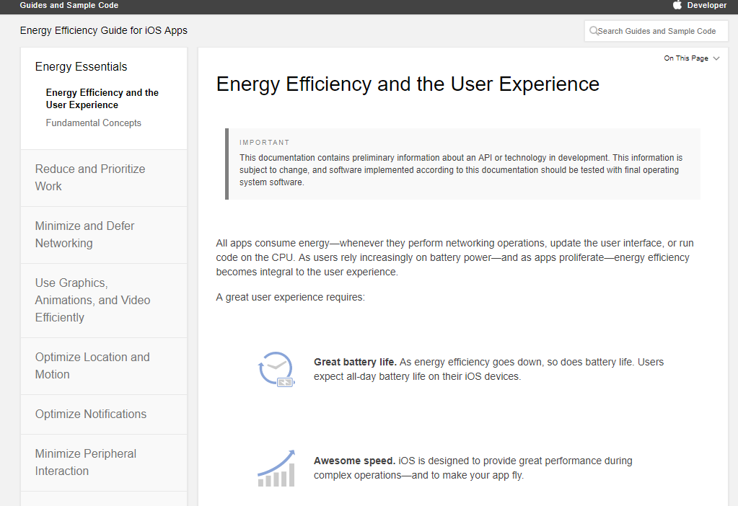
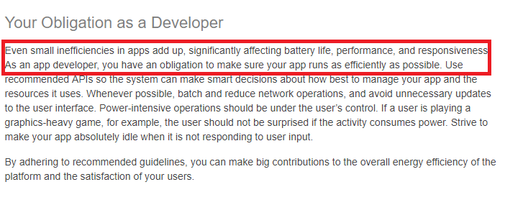
Why is this important? – Mobile

Slide 7
Why is this important?
“1% improvement translates in many years of salary for our best payed engineers per year in power cost alone.”
Andrei Alexandrescu, (ex) Facebook GoingNative conference – 2013 https://channel9.msdn.com/Events/GoingNative/2013/Writing-Quick-Code-in-Cpp-Quickly

Slide 8
In Sum
Hardware became faster, but in lots of scenarios performance is very important

